Slide 1

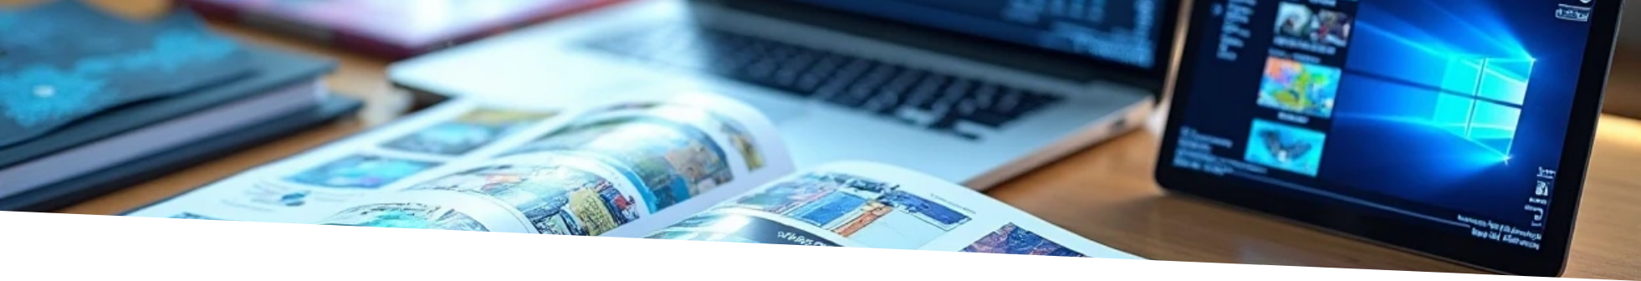

Portfolio
Author: NAVXXN 07
Created with Pi

Slide 2

CONTENTS
1. Personal Information
2. Contact Me

Slide 3

01
Personal Information

Slide 4

Name
NAVEEN B

Slide 5

Father's Name
BABU S

Slide 6

Mother's Name
SELVI B

Slide 7

Hobby
PLAYING GAMES

Slide 8


Contact Information
Mobile
8610411593
Email
navxxn1234@gmail.com

Slide 9

02
Contact Me

Slide 10

Contact Me
Explore our developer-friendly HTML to PDF API. Printed using PDFCrowd. HTML to PDF.

Slide 11

Thank You

